Slide 1
Assessment Findings
GitHub Link: https://github.com/satheeshkumar-r/Text_Classifier
Satheesh Kumar R
26/01/2022

Slide 2
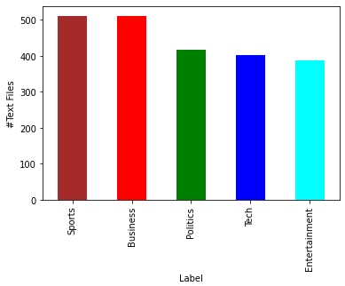
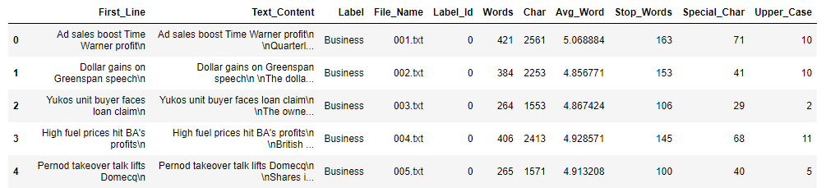
Feature Extraction & Text Pre-Processing
It’s a balanced dataset even though there are slight variations in number of text files in each labels.
Feature extraction performed on each text file and their results are stored in separate columns(Words: number of words, Char: number of characters, Avg_Word: Avg. word length, Stop_Words: number of stop words, Special_Char: number of special characters and Upper_Case: number of uppercase words).
Text pre-processing performed on each text file (removed digits, characters, stop words, most common 7 words and everything between the brackets. Made all character's lowercase)

Slide 3
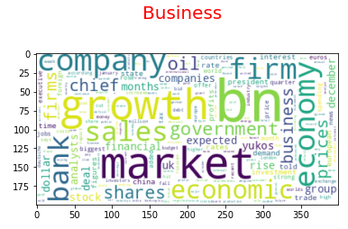
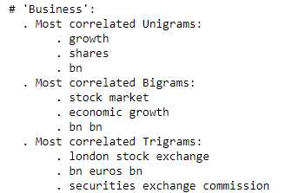
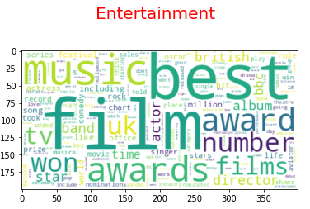
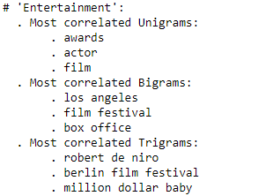
Text Representation

Slide 4
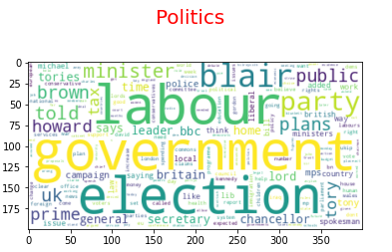
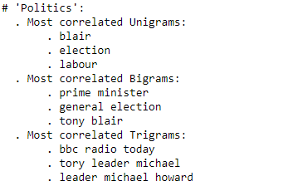
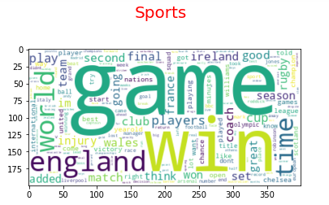
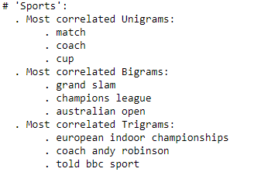
Text Representation

Slide 5
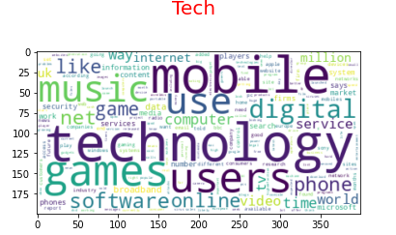
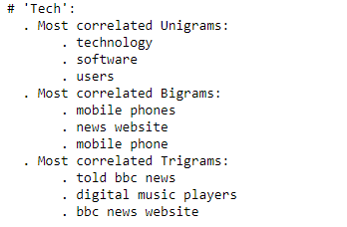
Text Representation

Slide 6
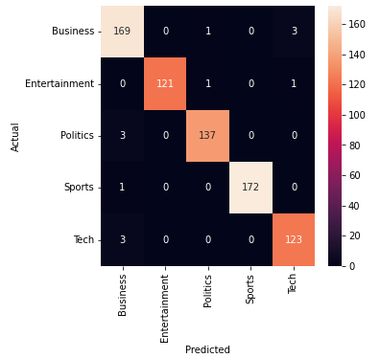
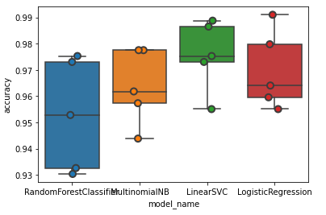
Model Selection & Evaluation
As we have text data with labels, we can perform supervised text classification
4 different algorithms considered for the analysis which includes Random Forest Classifier, Multinomial NB, Linear SVC and Logistic Regression
“Accuracy” metric used for determining the effectiveness of the algorithm
Linear SVC provides a higher accuracy of 0.975730 as compared to other classification algorithms
Confusion matrix build with Linear SVC classifier that predicts more accurately

Slide 7


